Slide 1
Capsule Network
汇报人：孙华琴
日期：2020年9月

Slide 2
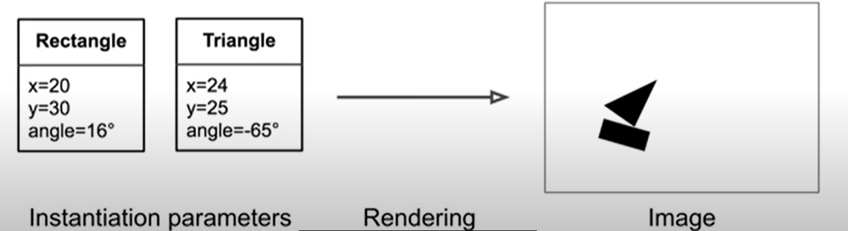
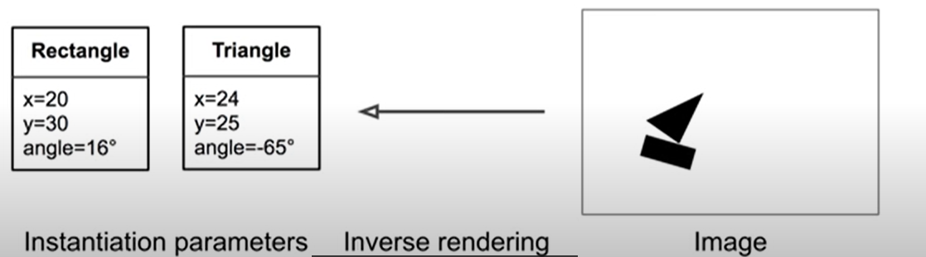
Computer Graphics
Notes:
inverse render你有有个图，你要找到图里每个object的参数，
Capsule 就是用来实现这个reverse

Slide 3
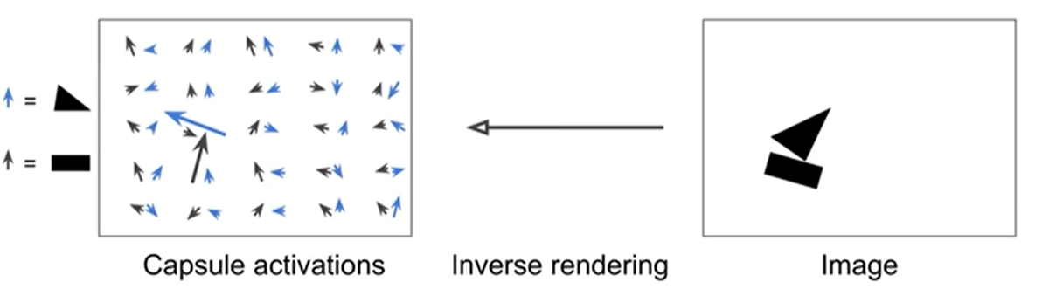
Capsule
A capsule is any function that tries to predict the presentence and instantiation parameter of a particular object at a give location
Notes:
比如说，左边有50个胶囊，每个胶囊的输出是一个vector，
蓝色的vectore是找三角形的胶囊，黑色的vector是找矩形的将囊
vector的长度表示存在的概率，可以看出只有两个地方的vector特别长 叫做active vector

Slide 4
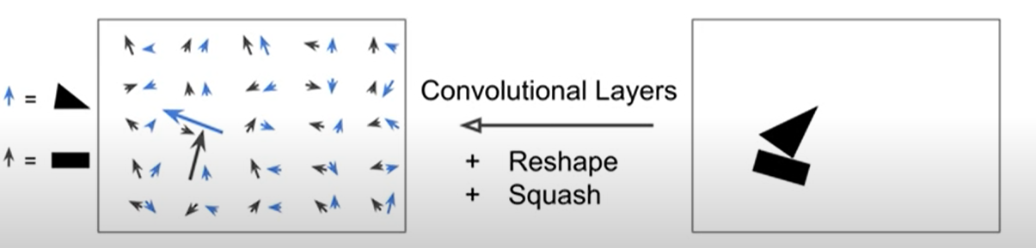
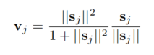
Capsule
A capsule is a group of neurons whose activity vector represents the instantiation parameters of a specific type of entity such as an object or an object part.
Notes:
那么如何从一副图像在得到这个capsule呢，可以用一堆CNN的neuron，把它们的输出集合一下得到几个vector
比如说在CNN里面你有18个neuron，那对于每个位置都可以有18个输出，reshape一下成2*9，就可以得到2个capsule每个有9维的特征
Squansh是因为这个vector的length代表概率，那么必须保证小于1

Slide 5
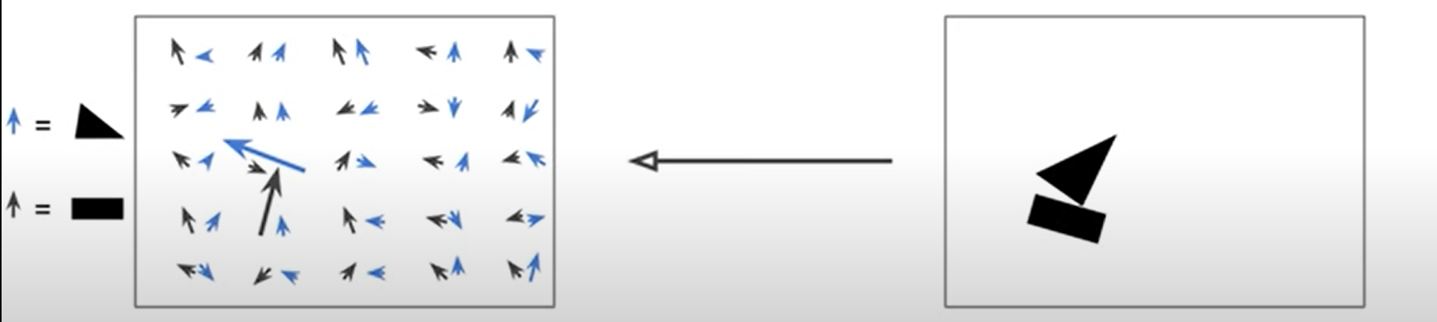
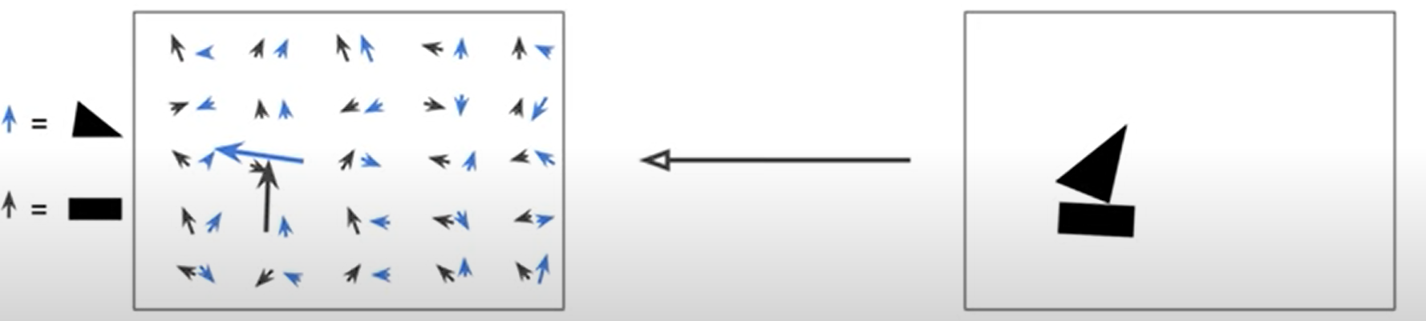
Equivariance
Key feature ：preserve detailed information
CNN：pooling layers, lose information
Equivariance and invairance
Notes:
重要的特征是保存了detailed information， 比如稍微转下，这个vector会变化
但是对于CNN来说，有pooling layer ，会损失信息，输出是一样的额。也就是

Slide 6
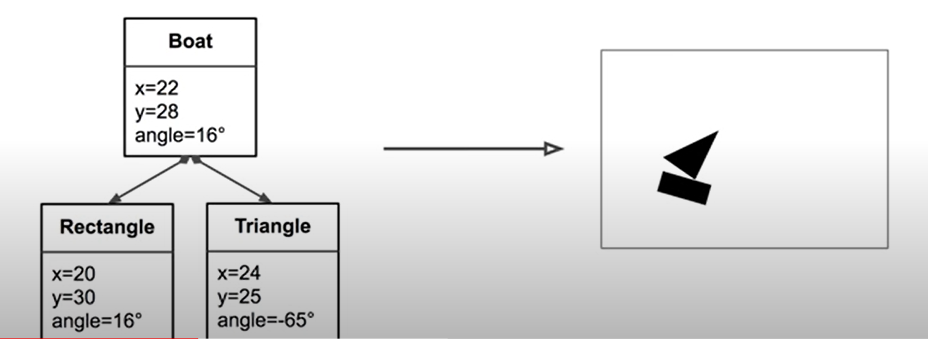
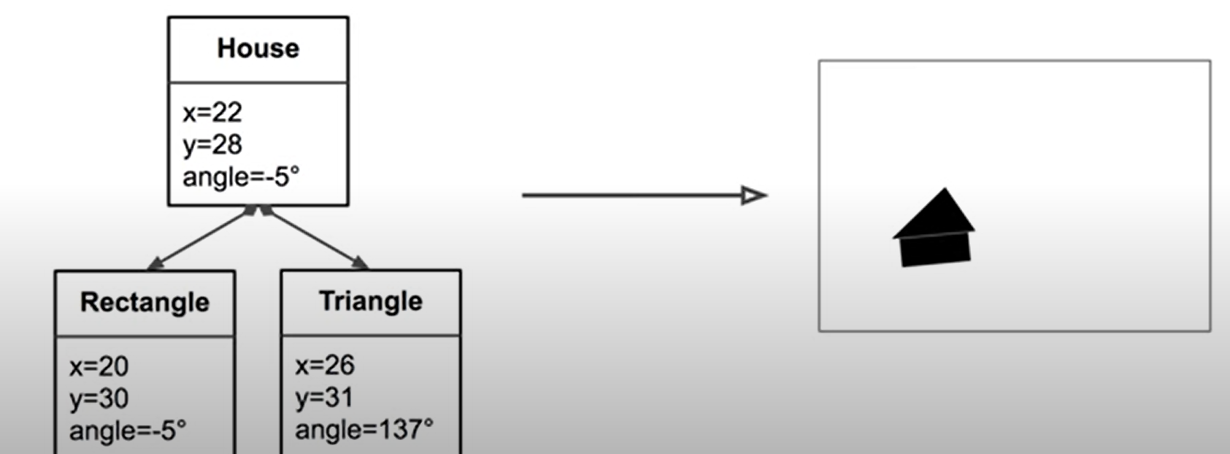
A hierarchy of Parts
Same part
Different arrangement
Notes:
Capsulenet，所以他的信息也是一层一层传递的，同样的part可以组成不同的上层capsule，假设上层是2个capsule

Slide 7
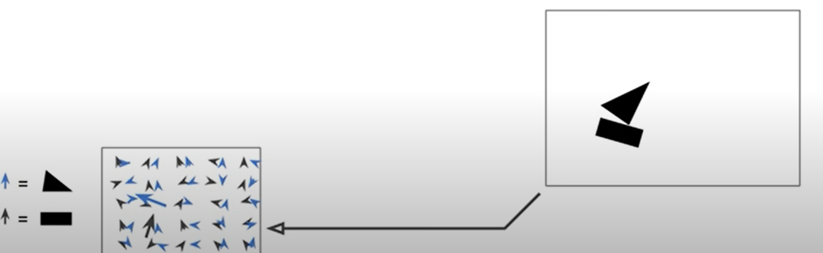
Primary Capsule
The capsule in the first layer try predict what the second layer capsule will output
Notes:
如何得到下一层呢，非常直觉的做法就是根据active vector中的位置信息能，算出下一层的active vector

Slide 8
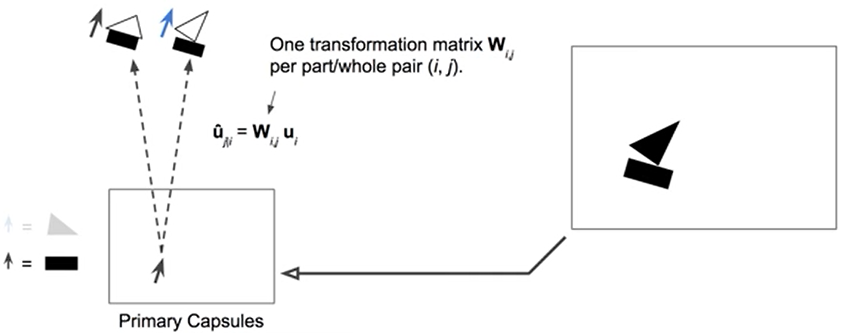
Predict Next Layer’s Output
Key feature ：preserve detailed information
Notes:
根据这个矩阵的方向，可以predict一下层的object的方向，W表示的是part-whole relationship，可以通过bp学习到

Slide 9
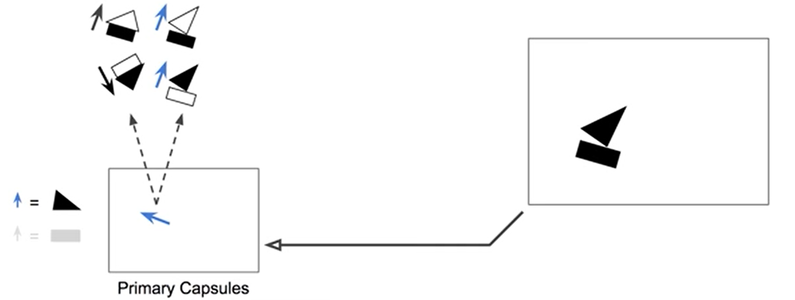
Predict Next Layer’s Output
Key feature ：preserve detailed information
Notes:
通过三角形也可以预测出whole的位置和形状

Slide 10
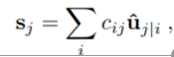
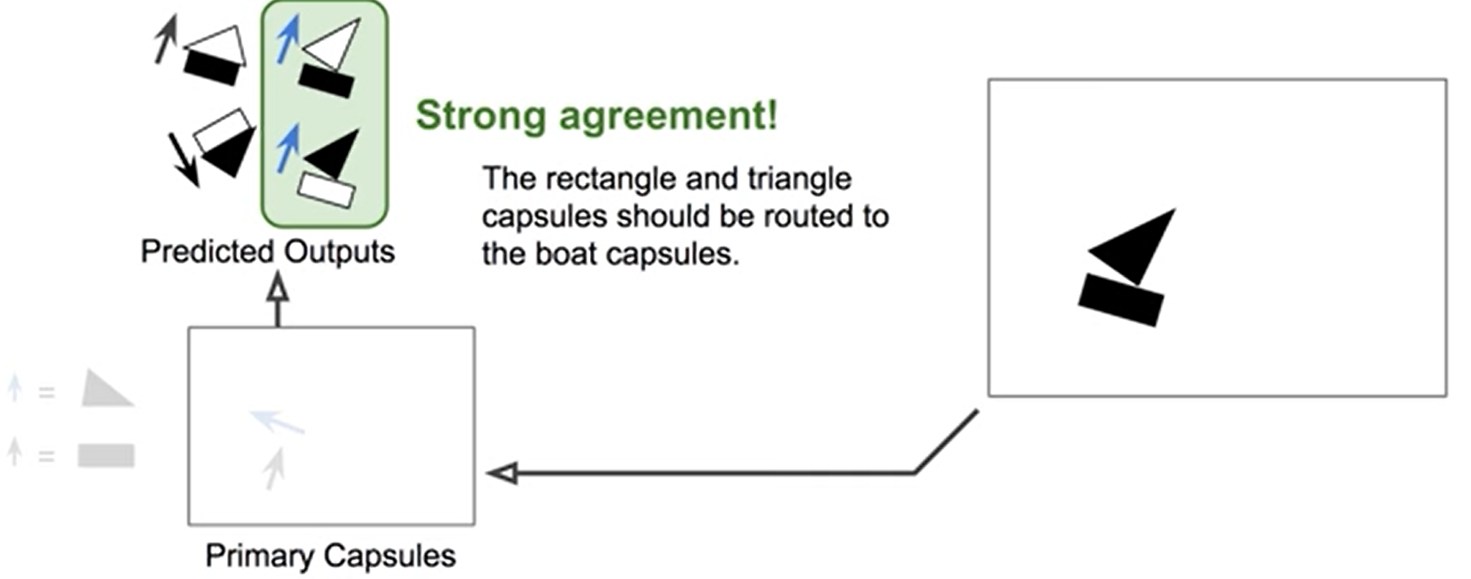
Routing by agreement
Notes:
Agrement大的就是可能的，因为active vector的length决定一个capsule是不是存在所以前面的系数就很重要，agreenment
可以看出预测出船的position非常一致，故预测出这个是一个boat
那么三角和正方形就要尽量多的送到boat sapsule中
好处：只送到正确的capsule中，对于正确的capsuke那么得到的数据更加准确，对于没有激活的capsule就有更少的噪声

Slide 11
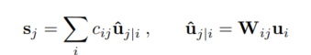
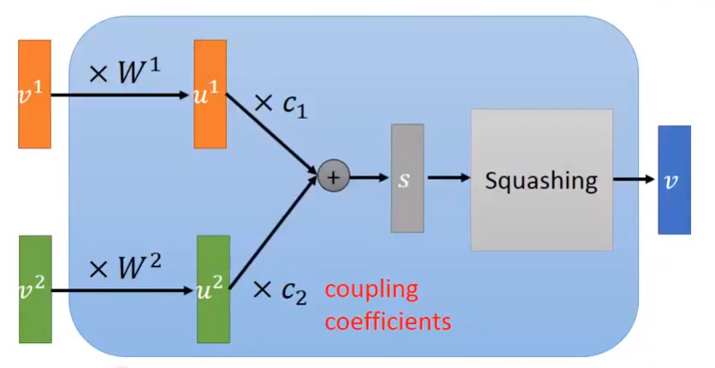
How the vector inputs and outputs of a capsule are computed
Notes:
the total input to a capsule sj is a weighted sum over all “prediction vectors” ˆuj|I from the capsules in the layer below and is produced by multiplying the output $u_{i}$ of a capsule in the layer below by a weight matrix $W_{ij}$
coupling coefficients log priors They depend on the location and type of the two capsules but not on the current input image2
.

Slide 12
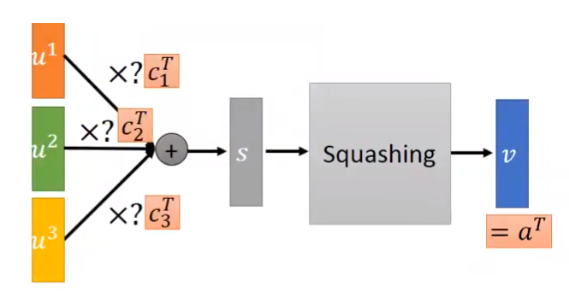
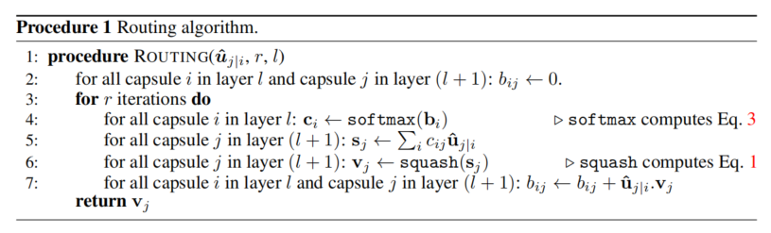
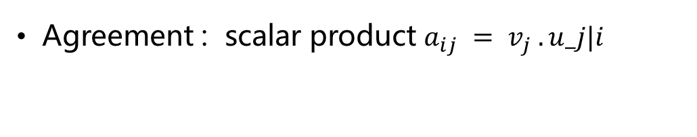
Dynamic routing
Agreement : scalar product $a_{ij} = v_{j} .u_j|i$
Notes:
This agreement is treated as if it was a log likelihood and is added to the initial logit, bij before computing the new values for all the coupling coefficients linking capsule i to higher level capsules.

Slide 13
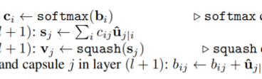
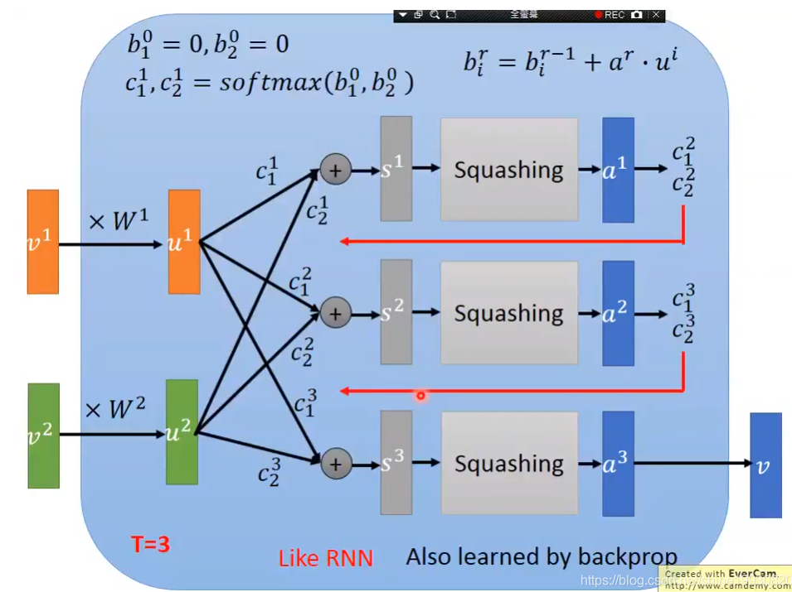
Routing-by-agreement
Notes:
Initially, the output is routed to all possible parents but is scaled down by coupling coefficients that sum to 1. For each possible parent, the capsule computes a “prediction vector” by multiplying its own output by a weight matrix. If this prediction vector has a large scalar product with the output of a possible parent, there is top-down feedback which increases the coupling coefficient for that parent and decreasing it for other parents

Slide 14
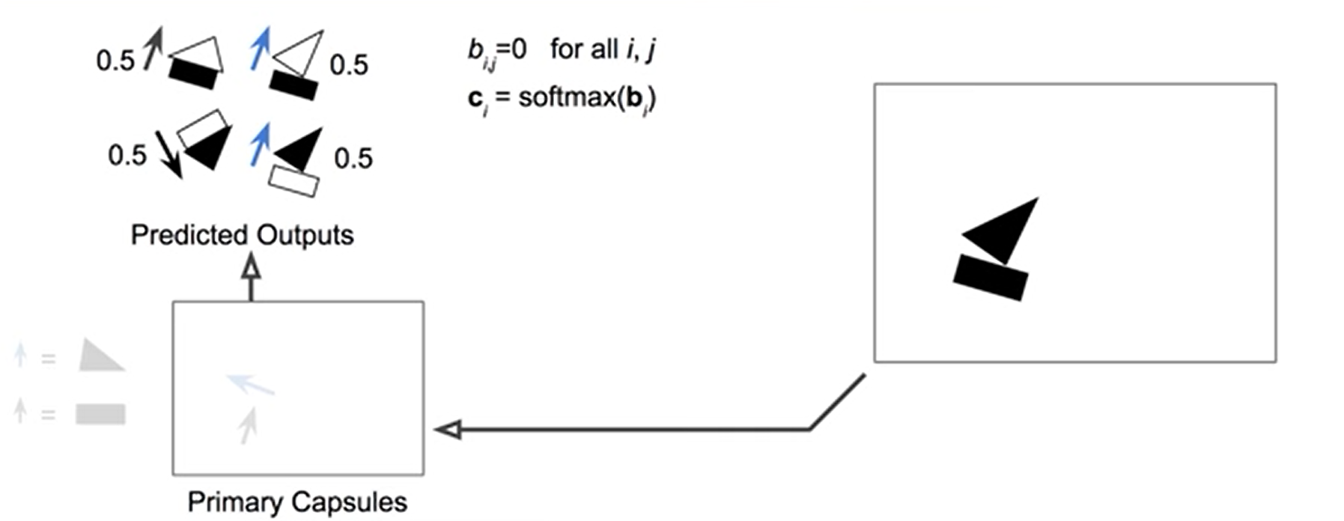
Routing by agreement
Notes:
初始化

Slide 15
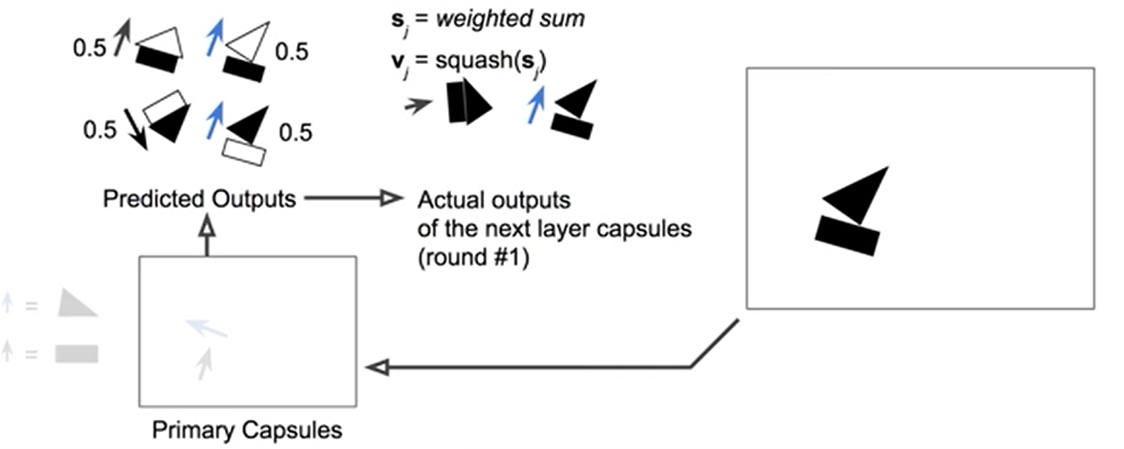
Predict Next Layer’s Output
Notes:
初始

Slide 16
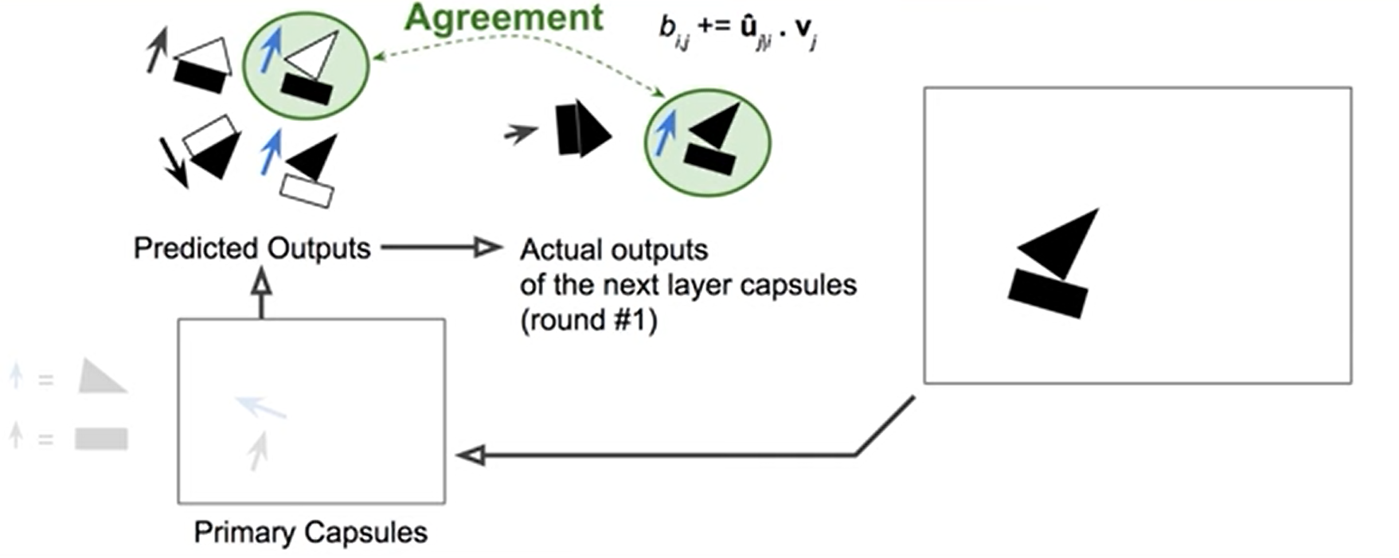
Predict Next Layer’s Output
Notes:
初始

Slide 17
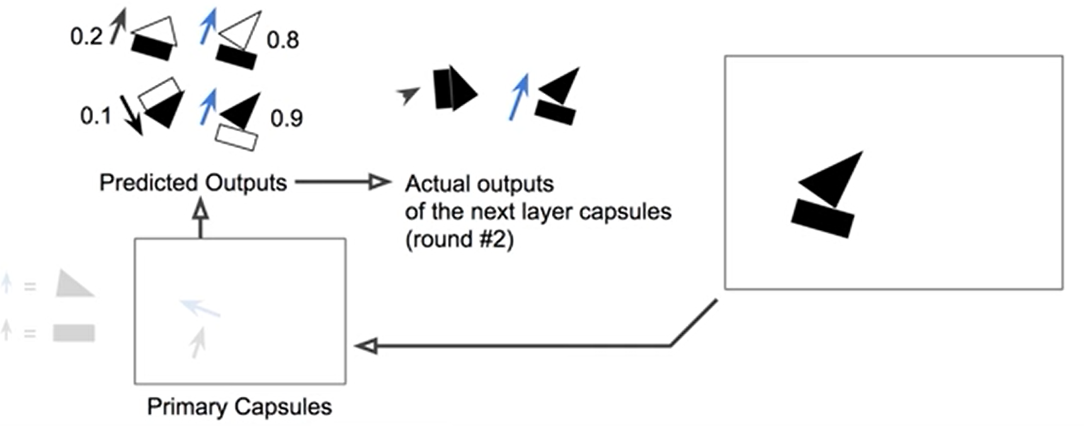
Predict Next Layer’s Output
Notes:
初始

Slide 18
Loss
Could use softmax using the length of vector
In the paper
mutiClass detector
Class k, Tk = 1 iff a digit of class k is present3 and m+ = 0.9 and mm = 0.1.
Notes:
这个loss可以用于多类的deteor，当一个class存在时，概率应该大于0.9，不存在，应该小于0.1

Slide 19
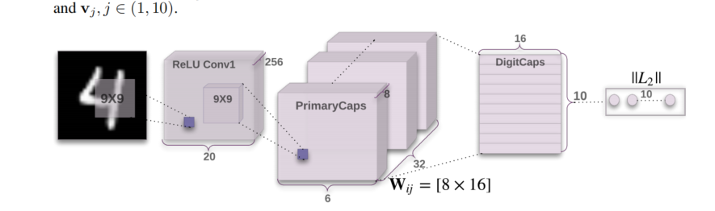
CapsNet architecture
Conv1 :converts pixel intensities to the activities of local feature detectors
primary capsules: from an inverse graphics perspective, activating the primary capsules corresponds to inverting the rendering process.
DigitCaps: routing only between two consecutive capsule layers
Notes:
Conv1 This layer converts pixel intensities to the activities of local feature detectors that are then used as inputs to the primary capsules

Slide 20
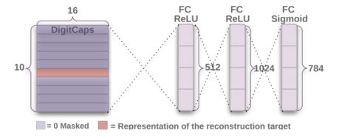
Reconstruction as a regularization method
We scale down this reconstruction loss by 0.0005 so that it does not dominate the margin loss during training

Slide 21
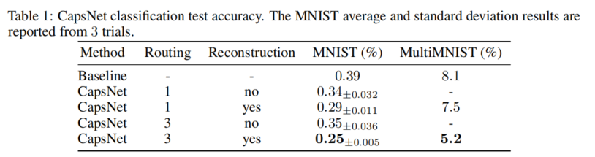
Capsules on MNIST
importance of routing and reconstruction regularizer.
the reconstruction regularizer boosts the routing performance by enforcing the pose encoding in the capsule vector.

Slide 22
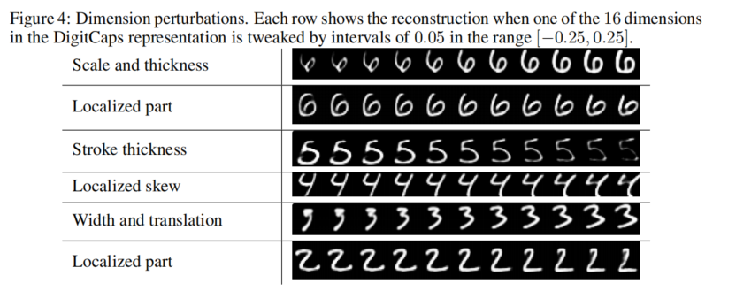
What the individual dimensions of a capsule represent
One dimension (out of 16) of the capsule almost always represents the width of the digit. While some
dimensions represent combinations of global variations, there are other dimensions that represent variation in a localized part of the digit.
Notes:
不同的dimension控制不同特征

Slide 23
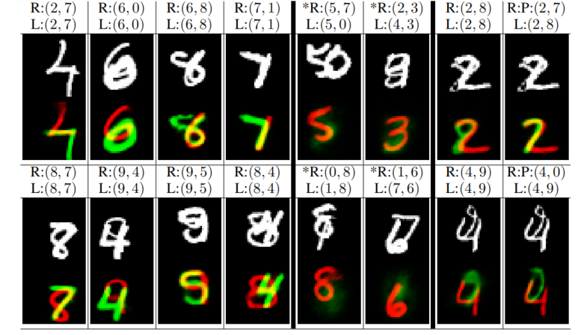
Segmenting highly overlapping digits
主要参数：Batch_size = 32 Epoch = 400
Notes:
重建的是彩色的，用不同颜色表示
L 是原图的label， R是用来重建的label
最左边的错处中，有预测错误的对比
在左二中，打星号的是强行做错的，可以看出他并不能重构出错误的label的图形，因为没有suppore的信息
就是训练的时候激活的作用，不会给没有存在的数字找最好的pixcel。These columns suggests that the model is not just finding the best fit for all the digits in the image including the ones that do not exist.

Slide 24
Compare with CNN
replacing the scalar-output feature detectors of CNNs with vector-output capsules and max-pooling with routing-by-agreement,
still like to replicate learned knowledge across space
For low level capsules, location information is “place-coded” by which capsule is active.
As we ascend the hierarchy, more and more of the positional information is “rate-coded” in the real-valued components of the output vector of a capsule.

Slide 25
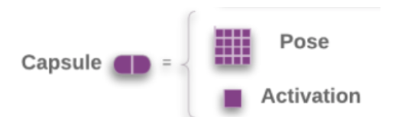
Matrix Capsules with EM Routing
A capsule is a group of neurons whose outputs represent different properties of the same entity.
Capsule
a logistic unit ：the presence of an entity
Pose matrix :4x4 matrix , the relationship between that entity and the viewer .
Vote :
Aim: the pose matrix of layer above
Method：1）multiplying own pose matrix by transformation matrices（ trainable viewpoint-invariant ）2）weighted by an assignment coefficient.（EM update）
Notes:
A capsule in one layer votes for the pose matrix of many different capsules in the layer above by multiplying its own pose matrix by trainable viewpoint-invariant transformation matrices that could learn to represent part-whole relationships
和之前的区别是先把active vector 拆开，层与层之间的routing 用的EM

Slide 26
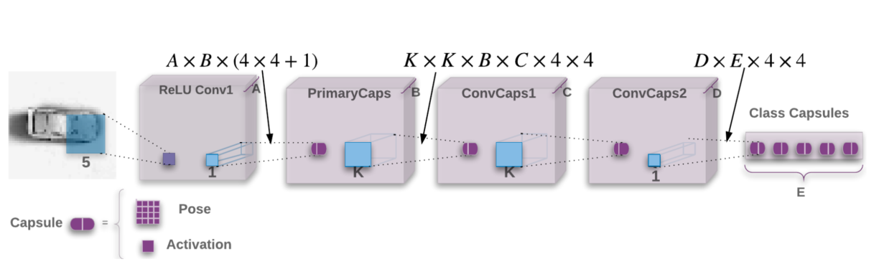
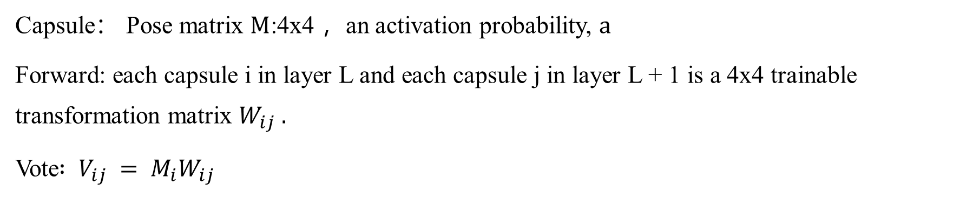
How Capsule Work
Capsule： Pose matrix $M$:4x4 ，an activation probability, $a$
Forward: each capsule i in layer L and each capsule j in layer L + 1 is a 4x4 trainable transformation matrix $W_{ij} .$
Vote$: V_{ij} = M_{i}W_{ij}$
Notes:
输入输出都是Capsule
The pose matrix of capsule i is transformed by Wij to cast a vote Vij = MiWij for the pose matrix of capsule j.

Slide 27
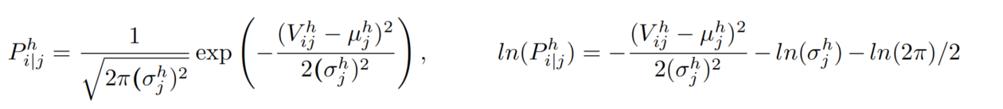
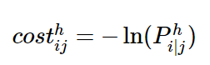
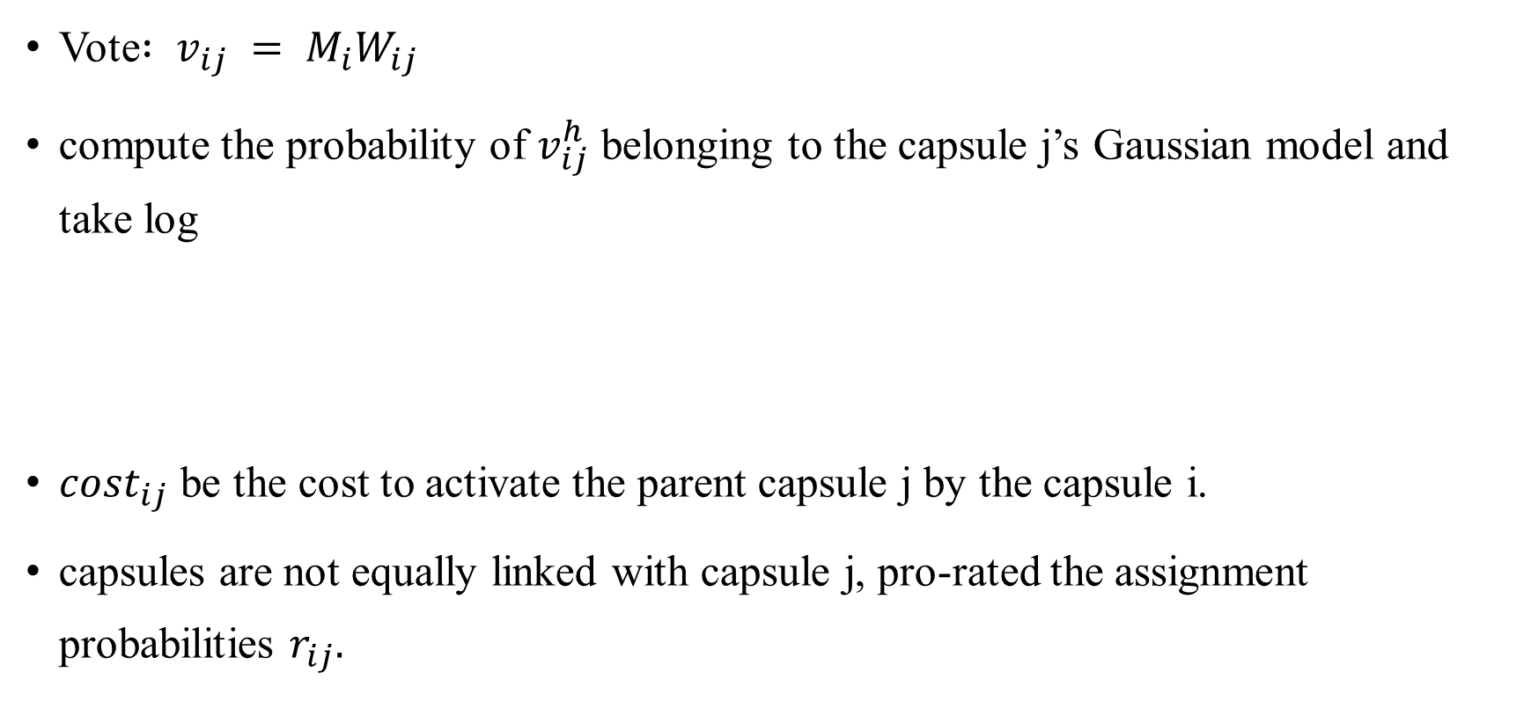
Using EM for Routing-by-agreement
Vote$: v_{ij} = M_{i}W_{ij}$
compute the probability of $v_{ij}^{h}$ belonging to the capsule j’s Gaussian model and take log
$cost_{ij}$ be the cost to activate the parent capsule j by the capsule i.
capsules are not equally linked with capsule j, pro-rated the assignment probabilities $r_{ij}.$

Slide 28
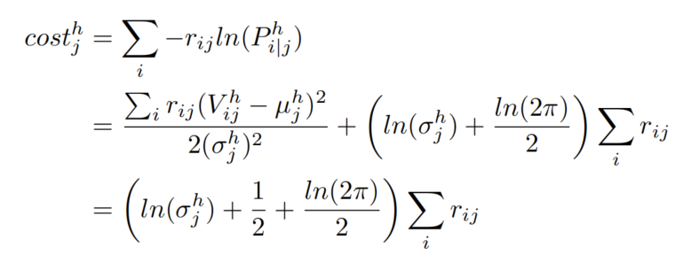
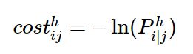
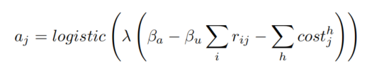
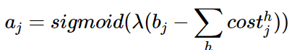
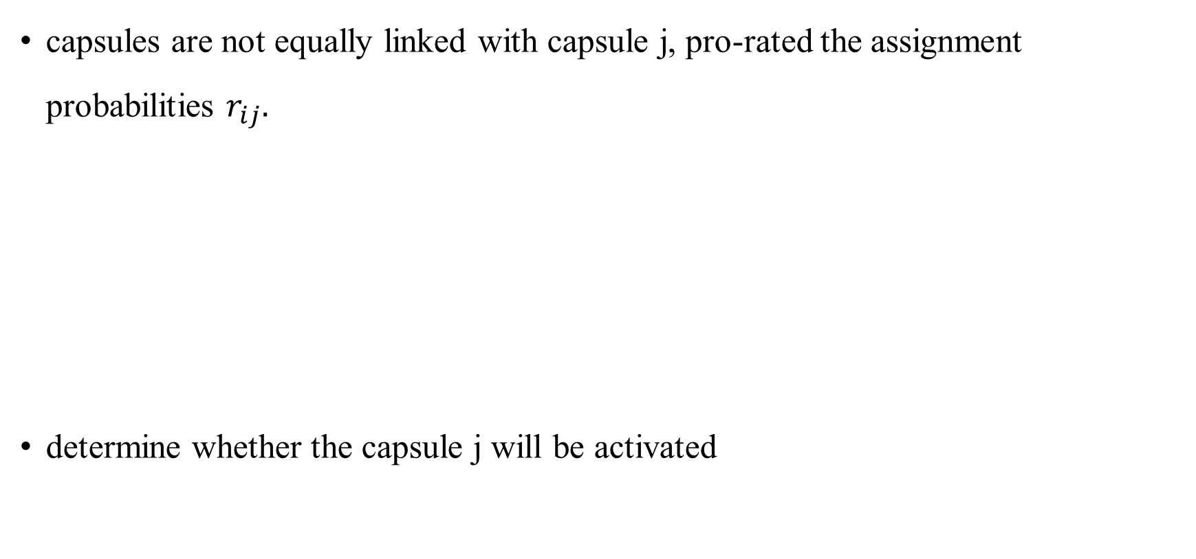
Using EM for Routing-by-agreement
capsules are not equally linked with capsule j, pro-rated the assignment probabilities $r_{ij}.$
determine whether the capsule j will be activated
Notes:
the cost of describing the mean and variance of capsule j
if the benefit bjbj of representing datapoints by the parent capsule jj outranks the cost caused by the discrepancy in their votes,
如果相似度大于一定阈值的话就季激活这个函数
$λ是$inverse temperature paramete， rij 编号的，让、lambda变大，

Slide 29
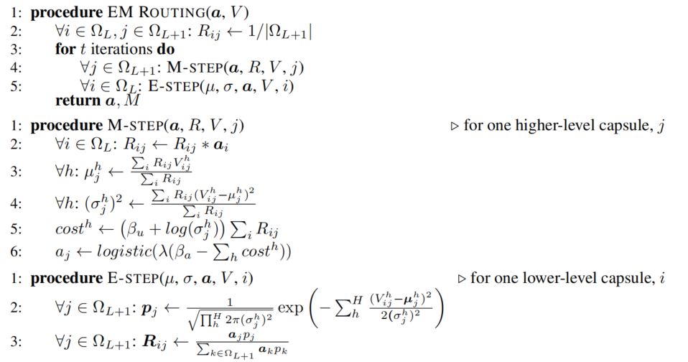
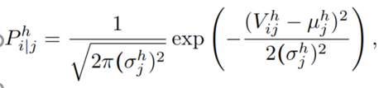
EM Routing
Notes:
先对r进行均匀初始化，进行M步， 因为ai是已知的，对rij有影响，计算高斯模型的均值和方差，用rij做权重， 计算cost，计算cost和aj（beta u 和 a是bp训练出来的）；进行E步骤，对所有维度计算得到极大似然估计值，得到i属于胶囊j的概率，对于所有j层的胶囊做归一化

Slide 30
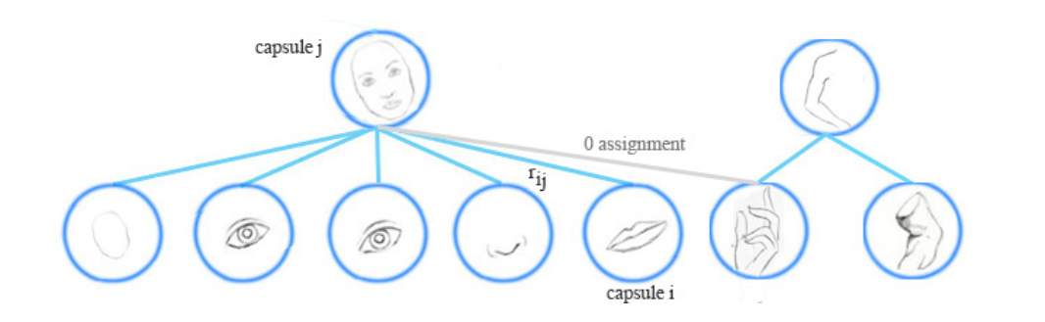
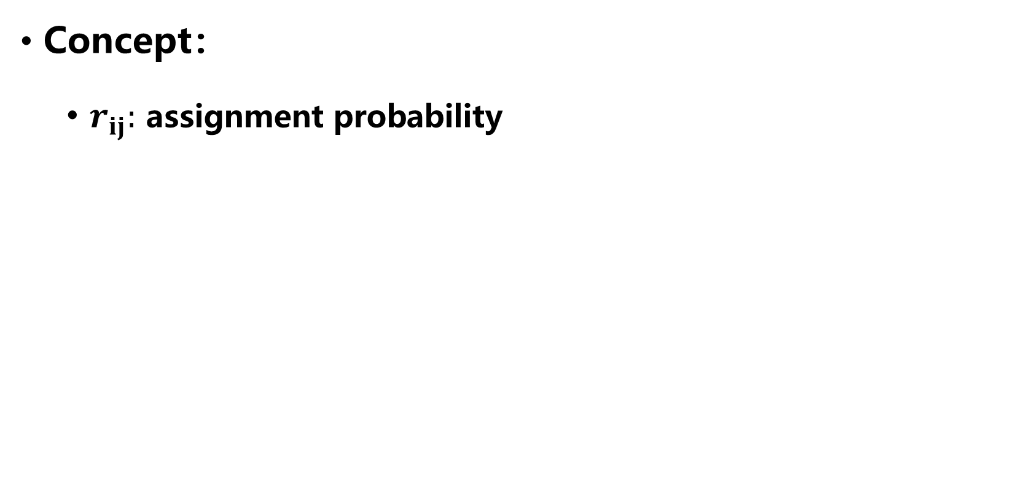
Using EM for Routing-by-agreement
Concept：
$r_{ij}:$ assignment probability
Notes:
胶囊i属于上层j的概率，主要受两个方面影响：1. j中是否存在I ，2. i是否被激活
对于1来说：又有两个方面的影响：1，与j的相似性，2，与j层别的胶囊不相似的地方

Slide 31
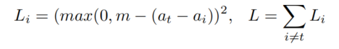
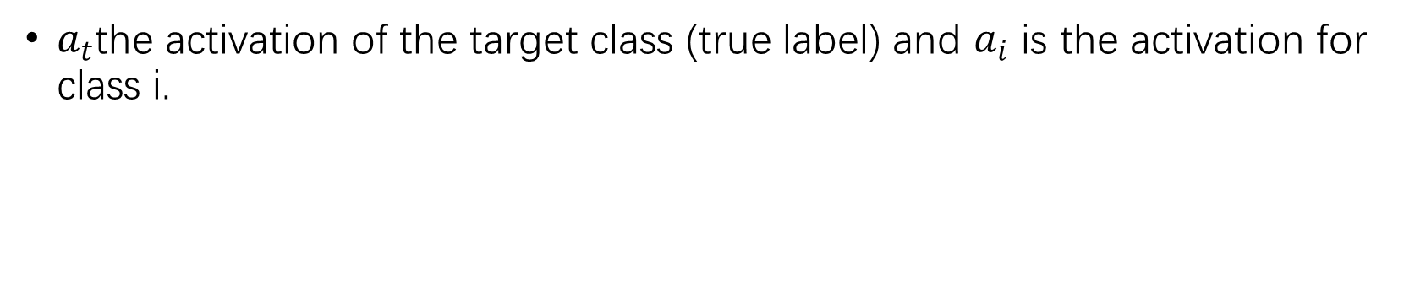
Spread Loss
$a_{t}$the activation of the target class (true label) and $a_{i}$ is the activation for class i.
Notes:
当at与ai间的margin小于m是，包括小于0，就平方这个误差，可以尽量拉开at与ai之间的差距。且m可以随着epoch动态调整，比如刚开始0.2 后随着递增0.1等，就会检查dead capsule的概率、

